Slide 1
Book1_v2023.1
File created on: 27-11-2023 18:10:15

Slide 2
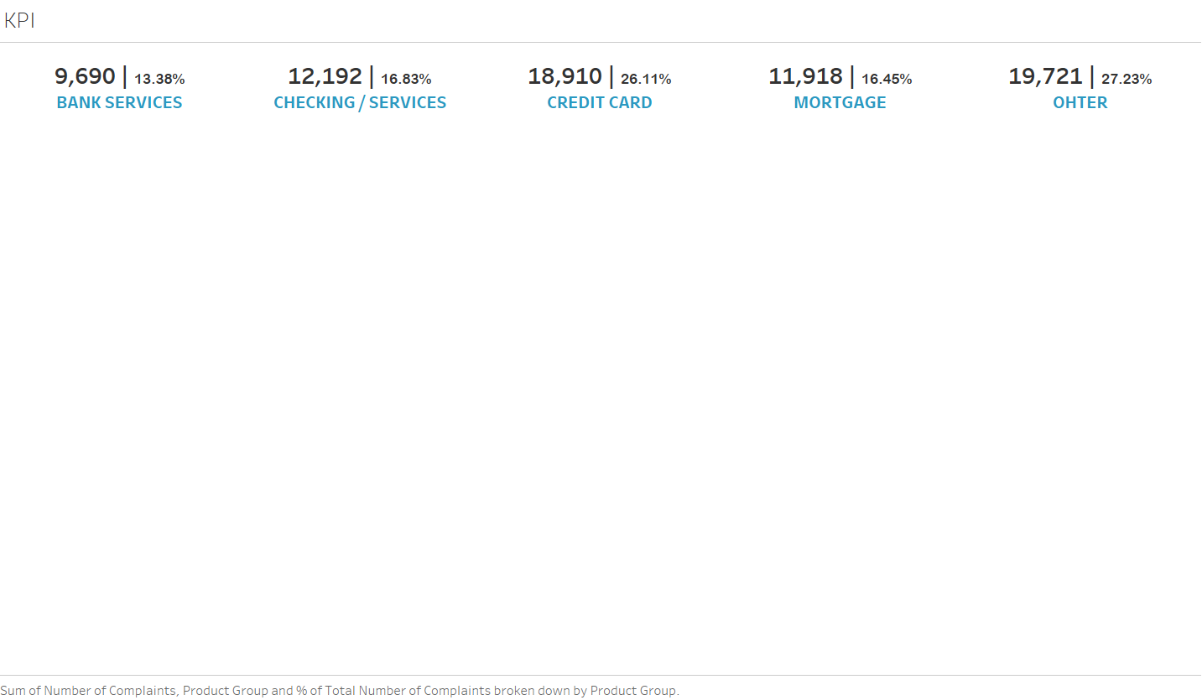

Slide 3
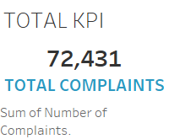

Slide 4


Slide 5
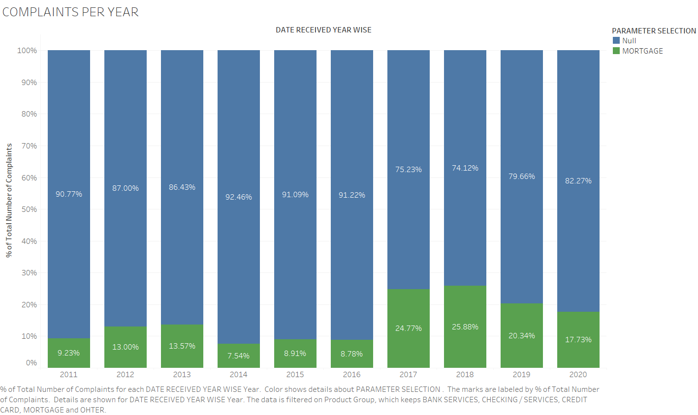

Slide 6


